Slide 1
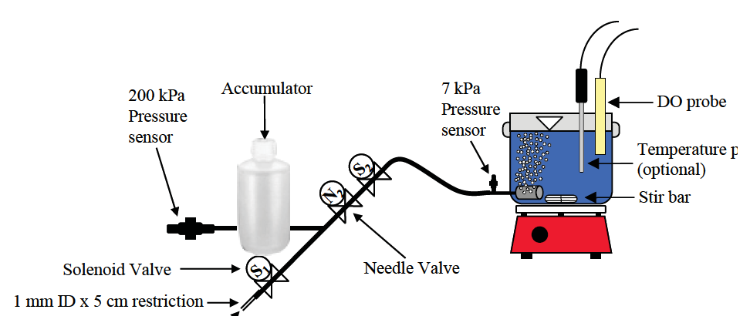
CEE 4530: Laboratory Research in Environmental Engineering
Spring 2019
Temperature probe
(optional)
Monroe Weber-Shirk
265 Hollister Hall
mw24@cornell.edu

Slide 2
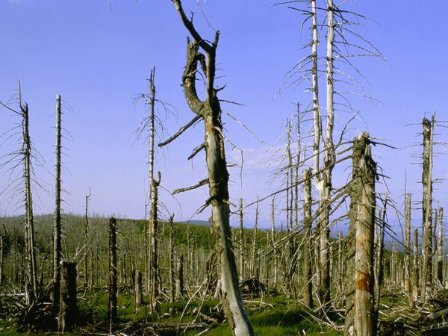
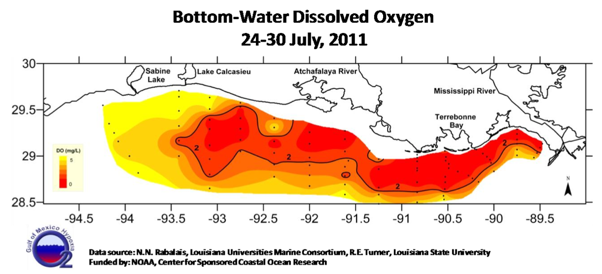
CEE 4530: Laboratory Research in Environmental Engineering
Acid Rain
Data source: N.N. Rabalais, Louisiana Universities Marine Consortium, R.E. Turner, Louisiana State University
Image from: www. environment.nationalgeographic.com
hypoxia
environmental contaminants

Slide 3
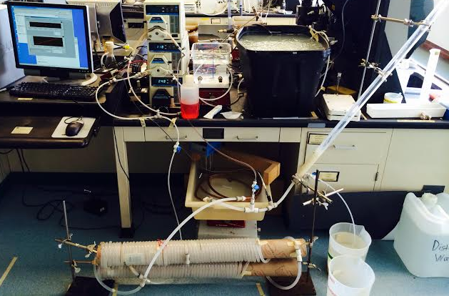
CEE 4530: Laboratory Research in Environmental Engineering

Slide 4
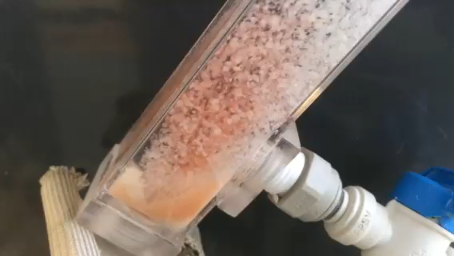
CEE 4530: Laboratory Research in Environmental Engineering

Slide 5
Agenda for our First Meeting
Reflections on 25 years of CEE 4530
Introductions
Course overview
Working in teams
Lab Safety
Anaconda, Atom, Hydrogen, Python
Notes:
I can go over a few safety procedures
I can introduce the course and explain some of my teaching philosophy
Then perhaps Cynthia and Jillian can guide the students to install and setup atom and hydrogen

Slide 6
Reflections on 25 years
1994 – New lab
X-Y plotters!
Switch to Macintosh computers
Custom software for meters/instruments
Lots of canned labs
Then the evolution
Less canned - 50% project
Ability to automate experiments
Python - Hydrogen

Slide 7
Course Goals To Help Students Develop:
An intuition for concepts seen in other classes
Laboratory skills
Research skills
Data analysis
Model development
Engineering skills
Designing systems to meet an objective
Troubleshooting and problem solving
Writing skills
Teamwork skills
Practice learning using methods that will work for a lifetime

Slide 8
Course Info
Web site
Schedule
Grades
Text: "Laboratory Research in Environmental Engineering: Laboratory Manual" https://monroews.github.io/EnvEngLabTextbook/

Slide 9
Course Elements
Laboratories – from canned to open-ended
Lectures/discussions
Prelab questions – done in teams
Laboratory reports – done in teams
Prelim (open internet, markdown/python, take home)
Project – done in teams

Slide 10
Projects
A chance to develop your engineering skills
Learn about process control, automation and application of lots of things that you’ve learned thus far!
Nutrient Removal Project
Research Project

Slide 11
Team Preferences?
Teams of 2
Fill out form today! (link on syllabus page)
We will assign you to a team in time for the Acid Rain laboratory

Slide 12
Your To Do list for 4530
Fill out team formation survey
Python Tutorial (due noon on Friday)
Do prelab assignment individually for Fundamentals Lab before lab on Wednesday

Slide 13
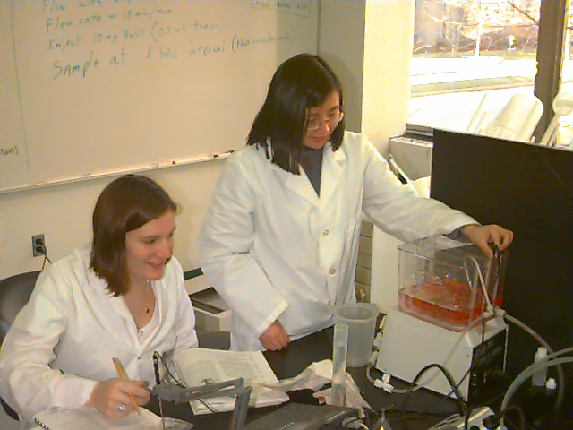
Cooperative Learning: Teamwork for Engineering Classrooms
Ideas from Karl A. Smith

Slide 14
Team Management Reflections
Think about your most successful/effective team project experience
What were the characteristics of the team?
What were the conditions?
Have you had experiences with teams that were ineffective or frustrating?
What made the team ineffective?
What could you have done to improve the team?

Slide 15
Types of Teams
High-Performing
Cooperative
members
team
Cooperative
Performance Level
Traditional
Pseudo
Types of Teams

Slide 16
Traditional Classroom Learning Teams
Team members:
Believe they will be evaluated and rewarded as individuals, not as a team
Interact primarily to clarify how assignments are to be done
Have no motivation to teach what they know to their teammates
May seek a free ride on the efforts of teammates
Or may feel exploited and do less

Slide 17
Cooperative Learning Teams
Have a goal of maximizing all members’ learning
Hold themselves accountable for doing high quality work
Work face-to-face for efficient communication to produce joint work-products
Help and encourage each other (academic and personal support)
Share responsibility for providing leadership
Analyze how effectively they are achieving their goals
Emphasize continual improvement of the teamwork process

Slide 18
High-performance Cooperative Learning Team
Meets all the expectations of the cooperative learning team
Outperforms all reasonable expectations, given its membership
High level of commitment
Mutual concern for each other’s personal growth
Achieve high-performance and also have lots of fun

Slide 19
What Makes Cooperative Learning Work?
Positive interdependence
Face-to-face interaction
Individual accountability/personal responsibility
Teamwork skills
Group processing
How are we doing as a team?
What could we do better?
What challenges are we facing?

Slide 20
Danger signs
High achiever paired with procrastinator
Procrastinator becomes less and less involved
High achiever becomes frustrated
Procrastinator learns little and gets a low final grade (team participation rating is a multiplier)

Slide 21
Antidote to Disengagement
Engagement!
Insist on being a full member of the team
Real time collaboration

Slide 22
Course Grading
Not on a curve
You are not competing with your classmates
If you all do well, you will all get good grades
Cooperation is rewarded, not penalized

Slide 23
A Few Safety Rules
Think through each step before beginning an experiment
Identify possible hazards and take appropriate measures to contain or minimize hazards (read labels)
If you don’t know what is going to happen and think there may be a potential for danger
Stop!
Get help before proceeding or modify procedure to minimize risk.
When using hazardous chemicals use secondary containment and appropriate personal protection

Slide 24
Unattended Experiment Guidelines
Prepare for power failure, _______ failure, or a leak
__________ containment of hazardous chemicals
Prepare for flooded and ____ conditions
Do not let equipment such as power stirrers, hot plates, heating mantles, and water condensers run overnight without ________ provisions and the instructor's consent
software
Secondary
dry
fail‑safe

Slide 25
Unattended Experiment Guidelines
Everything well secured
Check unattended reactions periodically
Post contact information
Accurate instructions and _______ for emergency personnel
labels

Slide 26
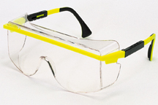
Routes of Chemical Exposure
skin
protective clothing
gloves
ingestion
don’t pipette by mouth!
no food in the lab
wash before leaving the lab
inhalation
dust and vapors (use fume hood when either are present)
eyes
eye protection against splashing and vapors
Wash your hands often (with your gloves on)
Notes:
mention chronic vs. acute exposure

Slide 27
Safety Data Sheets: an information source
Emergency information
chemical product and company identification
composition
hazards identification
Appropriate response to hazardous situations
first aid measures
fire fighting measures
accidental release measures
http://chemicalsafety.com/sds-search/

Slide 28
Safety Data Sheets: an information source
Prevention of hazardous situations
handling and storage
exposure controls and personal protection
physical and chemical properties
stability and reactivity
Miscellaneous
toxicological information
ecological information
disposal considerations
transportation information
regulatory information

Slide 29
Safety Data Sheets: an example - Hydrochloric Acid
You’ve been asked to mix up a solution of 1N HCl from concentrated hydrochloric acid. You would like to know of any hazards associated with this procedure.
You remember the safety rule and you think through the steps of preparing the solution. You realize that you’ve never opened a container of concentrated HCl before. So you STOP! and get some help.

Slide 30
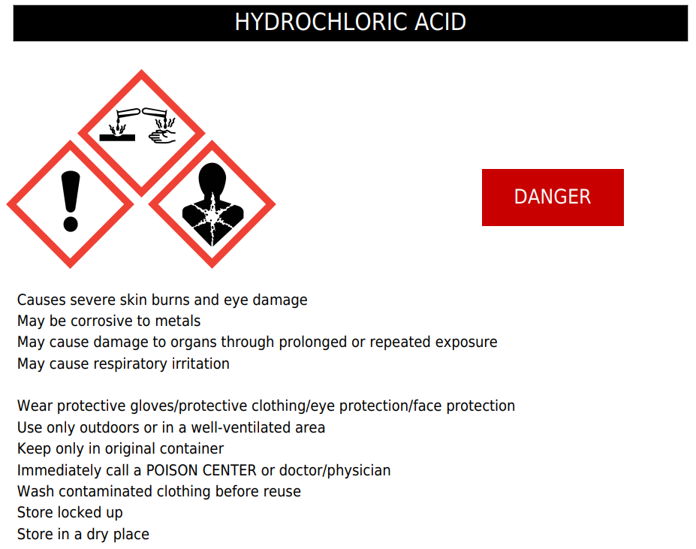
Notes:
https://chemicalsafety.com/sds1/createlabel.php

Slide 31
Hydrochloric Acid: My Solution to the solution
Ventilation is required!
Solution preparation should be done in a fume hood with gloves, protective clothing, and eye protection

Slide 32
SDS: Summary
A good source of information on safe handling
May provide useful information on physical-chemical properties
Provide first aid, fire fighting, and accidental release measures
Can be used to obtain concentrations of ingredients in proprietary solutions

